Slide 1
METALS IN YOUR BODY!
Miss Rohm
Notes:
This PowerPoint is designed to go along with the student worksheet.
Discuss #1. What metals have you had contact with today?
What do you know about metals- strong, shiny, conduct, magnetic.
Does it surprise you to learn that there are metals in your body?
Discuss # 2 What do you think would happen if you ate some metal? BEFORE you go to the next slide- ask them about this.

Slide 2
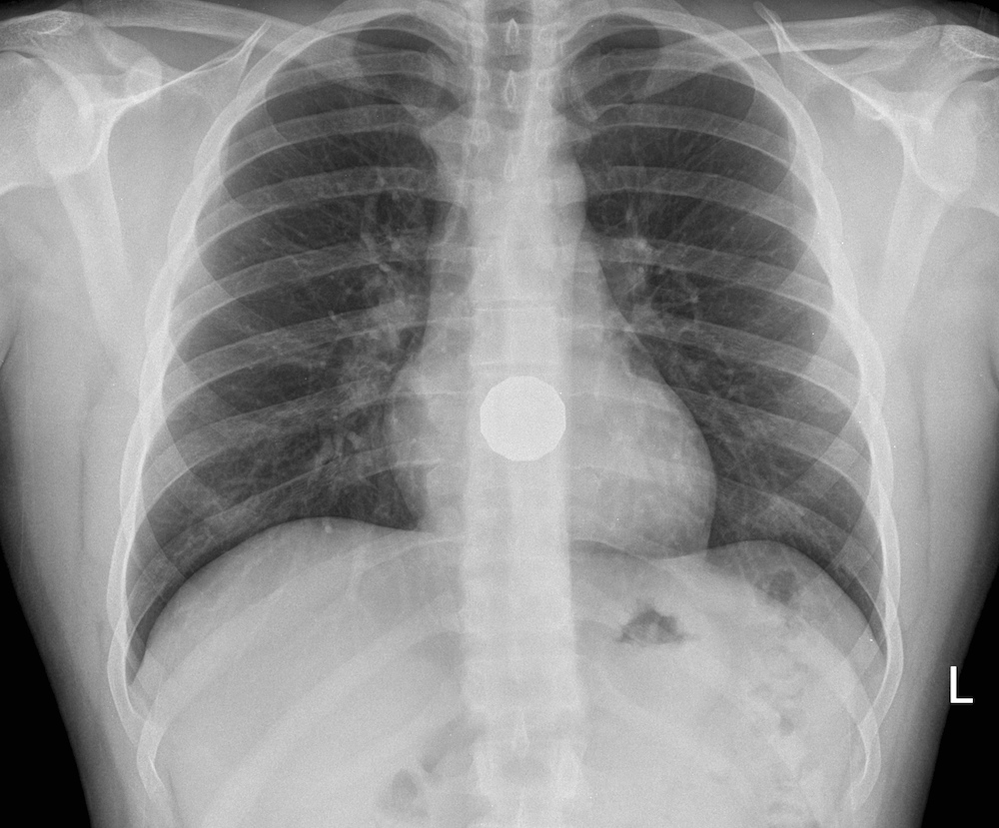
Don’t swallow anything metal !!!!
Notes:
#2 worksheet question.
Warn students that although God designed their bodies with metals in them, they should never try to eat metals. They cannot be digested. They could cause serious injury. This person swallowed a coin that will require surgery to remove.

Slide 3
Notes:
Since 50-70% of the body is water, it is also 50-70% H and O. Water is 2 hydrogens and one oxygen.
Carbon, oxygen, nitrogen, and hydrogen are NOT metals.
What percent is not shown on this diagram? 4% “other” Some of those “other” elements are metals.
#3 worksheet. Most common element in body is oxygen. Not because of the air we breath, but mostly from water in our bodies. H₂O

Slide 5
Which elements are metals?
Oxygen | Nitrogen | Iron | Chlorine
Carbon | Calcium | Sodium | Copper
Hydrogen | Magnesium | Potassium | Zinc
Notes:
#4 worksheet. Students may predict which ones they think are metals. This slide is animated so the next click will reveal the answer.
There are 118 elements total. There are 60 elements in the human body. These are some of them. Have students guess to see if they know which ones are metals. You could show a periodic table with the dividing line to separate metals from nonmetals.

Slide 6
Description of metals.
shiny
Most metals are _______________, conduct ____________ and electricity
Some metals explode when they touch ____________
Some metals are magnetic
heat
water
Notes:
#5 worksheet question.

Slide 7
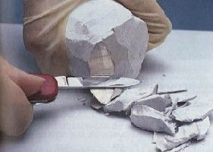
sodium
video
Notes:
Have samples of metals at lab station for them to look at:
Copper, magnesium, calcium, zinc, etc.
Sodium and potassium are too reactive to be safely included in this lab.
Notice that sodium is soft enough to be cut with a little knife. Shiny on the inside.
The video shows sodium exploding. There are more exciting videos of sodium- being thrown in a lake, etc. .. But most of those videos do not show safe handling procedures and are disruptive to the environment. I do not want to encourage that with my students.

Slide 8
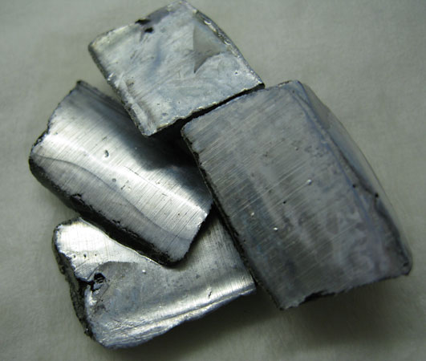
potassium

Slide 9
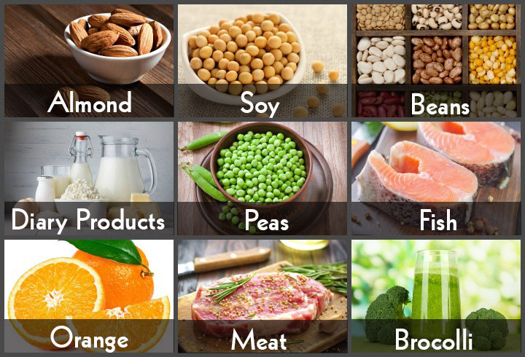
Calcium
strong
bones and
teeth
Dairy
Notes:
The next few slides show a series of metals and foods containing them. Discuss with your students the importance of a balanced diet. When your parents say “This is good for you, you should listen to them.”

Slide 10
Magnesium
steady heart beat

Slide 11
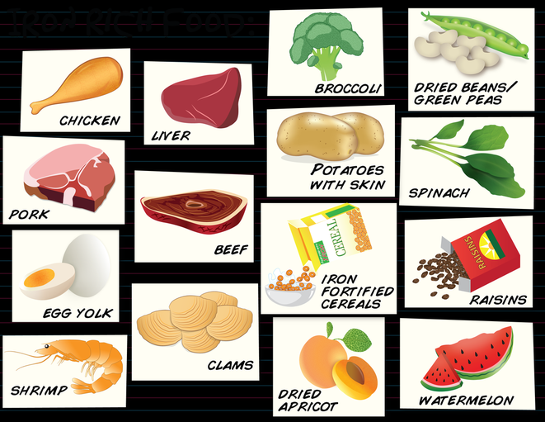
Iron
red blood
cells,
carry oxygen
Notes:
Super important. In fact, when you go to donate blood the first thing they do is test your iron levels. If it is not high enough they send you home.

Slide 12
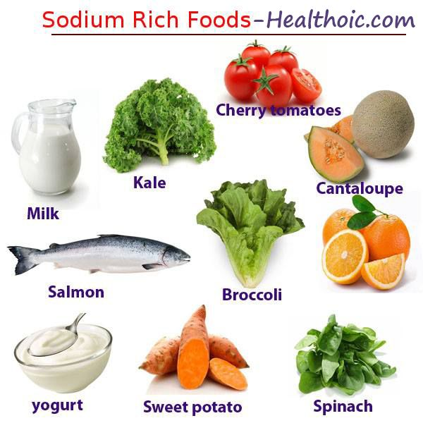
Sodium
prevents
cramps
Lettuce
Oranges
Notes:
An electrolyte- conducts electrical impulses in your body. Supports good mental function, prevents muscle cramps.
Pure sodium explodes on contact with water. Do you think God put pure sodium in your body? No. Your body has been wisely designed with a safe form of sodium.

Slide 13
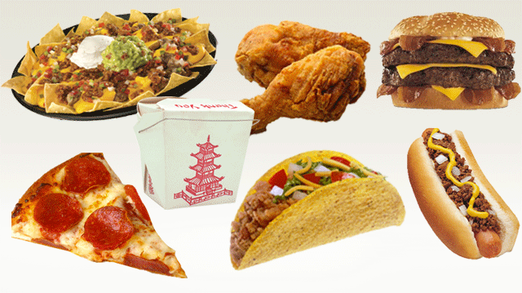
Sodium
electrolytes
Notes:
Americans eat so much junk food. Yes, sodium is an electrolyte and it is important for your diet. However, too much salt is bad for your diet. These foods, and other processed foods/fast foods contain too much salt to be considered healthy. They also contain too much fat.

Slide 14
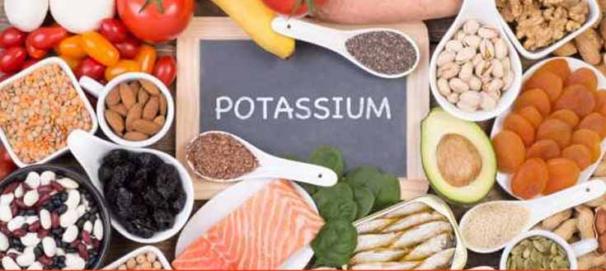
Potassium
prevents cramps
Notes:
Students might know that bananas contain potassium. Potassium is an electrolyte, conducts electrical impulses in the body. If you have leg cramps at night, try eating a banana.

Slide 15
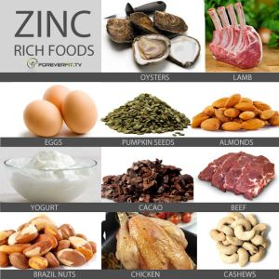
Zinc
○ Fights
sickness
Notes:
There are some cough drops that specifically advertise that they contain zinc.

Slide 16
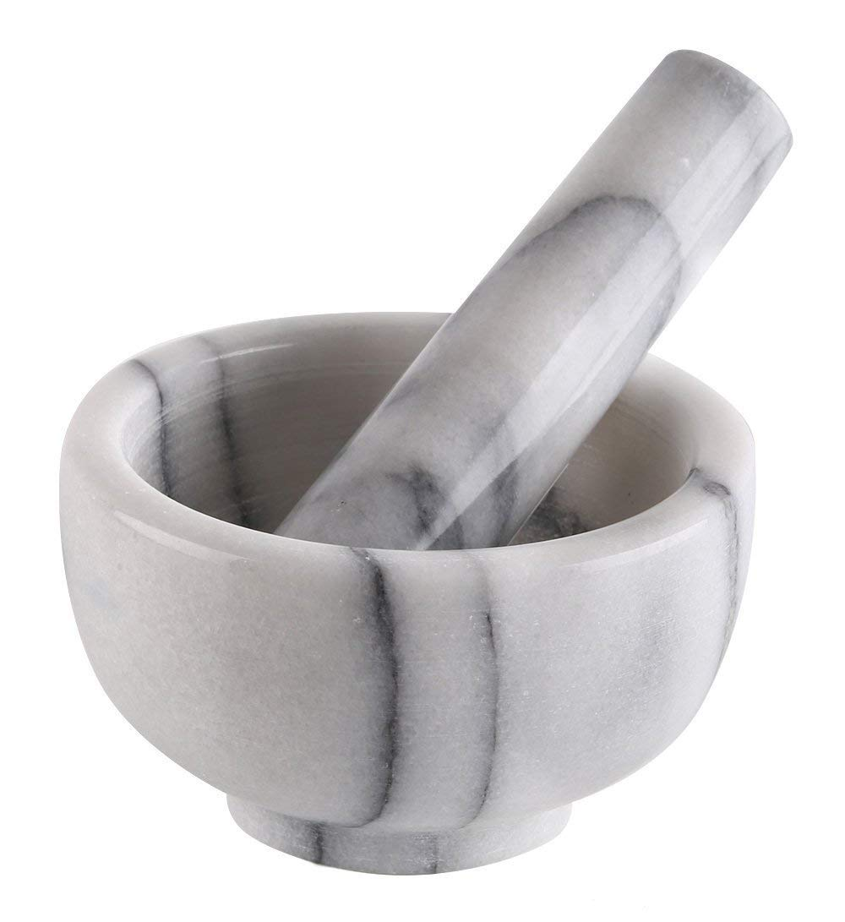
mortar and pestle
Notes:
Used to crush/ grind into powder. If you have the equipment, use it.
You can double bag in plastic bags and have students crush another way. You could put into a blender or food processer. You could crush it at home to save time, but it is part of the fun.

Slide 17
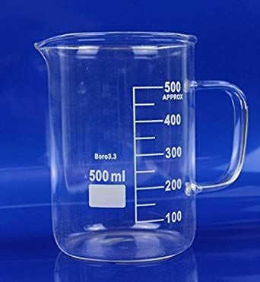
beaker
Notes:
Glass. Fragile.
**You can substitute foam cups. Not going to break. Just throw them away instead of having to wash them.

Slide 18
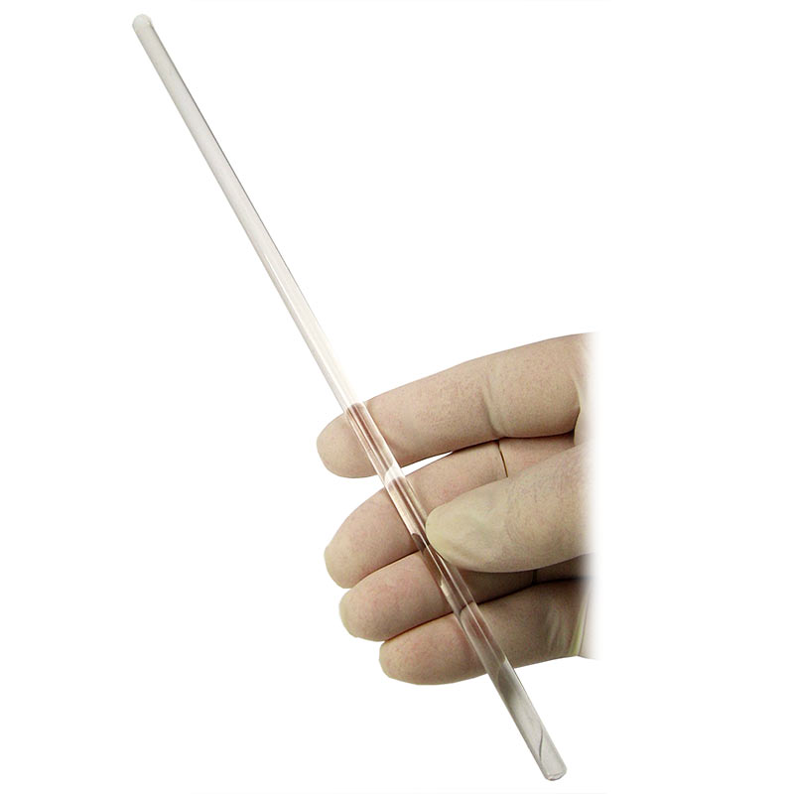
stirring rod
Be careful !!!
Notes:
Glass. Not a toy.
If you do not have, use a spoon.

Slide 19
electric kettle
Be careful !!!
Notes:
This is what I used to heat the water. NOT BOILING- that is dangerously hot. You could use a microwave.

Slide 20
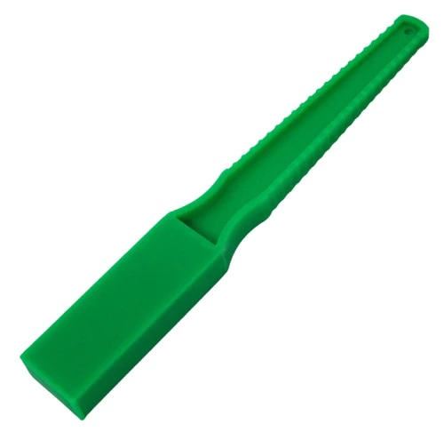
magnetic wand
Notes:
Or a magnet taped to the end of a popsicle stick.

Slide 21
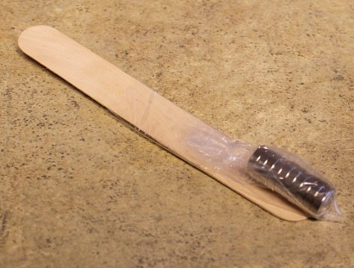
magnets on a stick

Slide 22
Crush the cereal using the mortar and pestle.
Put the crushed cereal into plastic bag, which is in the beaker.
Ask the teacher to add hot water to the 300 mL mark. Stir with the stirring rod. This will create a slurry.
Seal the bag with very little air. Lay it flat on the table.
Slowly move the magnet over the bag. Always move towards the same corner of the bag.
Notes:
I displayed the directions on the board during the lab. I did not print out a set of directions for every group.

